Slide 1

Action Lab: Building the Future with Purpose
PELS & SELS
January 28, 2026

Slide 2

Agenda
Meet 2026 – 2027 RIP Olayinka Babalola
Building Our Future with Purpose
Rotary’s Action Plan
What Now?
What’s Next?
Resources

Slide 3

Meet 2026 – 2027 RIP Olayinka Babalola

Slide 4
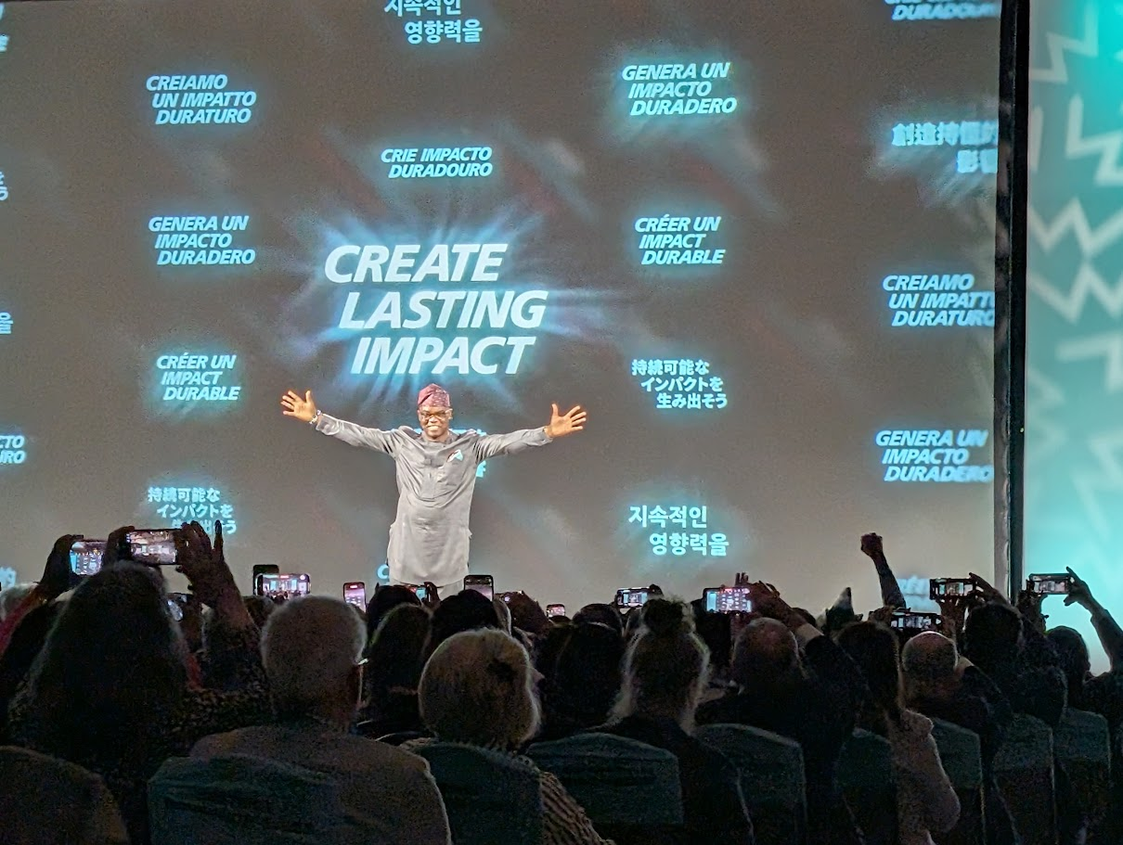
2026-2027 RIP Olayinka Babalola’s Message
Notes:
Create Lasting Impact – what does that mean? Discussion – chat or put up your hand
Lasting impact is what remains after the project ends.
It’s not just the hours served or dollars raised, but the change that continues because we planned for sustainability, partnerships, and leadership beyond a single Rotary year.

Slide 5
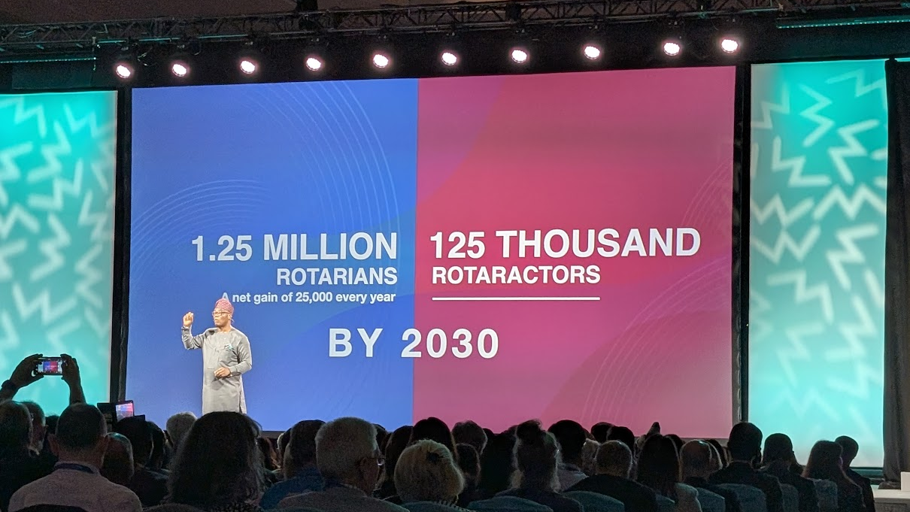
Notes:
Membership Goals – 25,000 new members every year by 2030
We have about 1700 members in our district. If every one of us brought in one new member in the next 5 years, we would have 3,400 members and doing more than our share to achieve the goal.

Slide 6
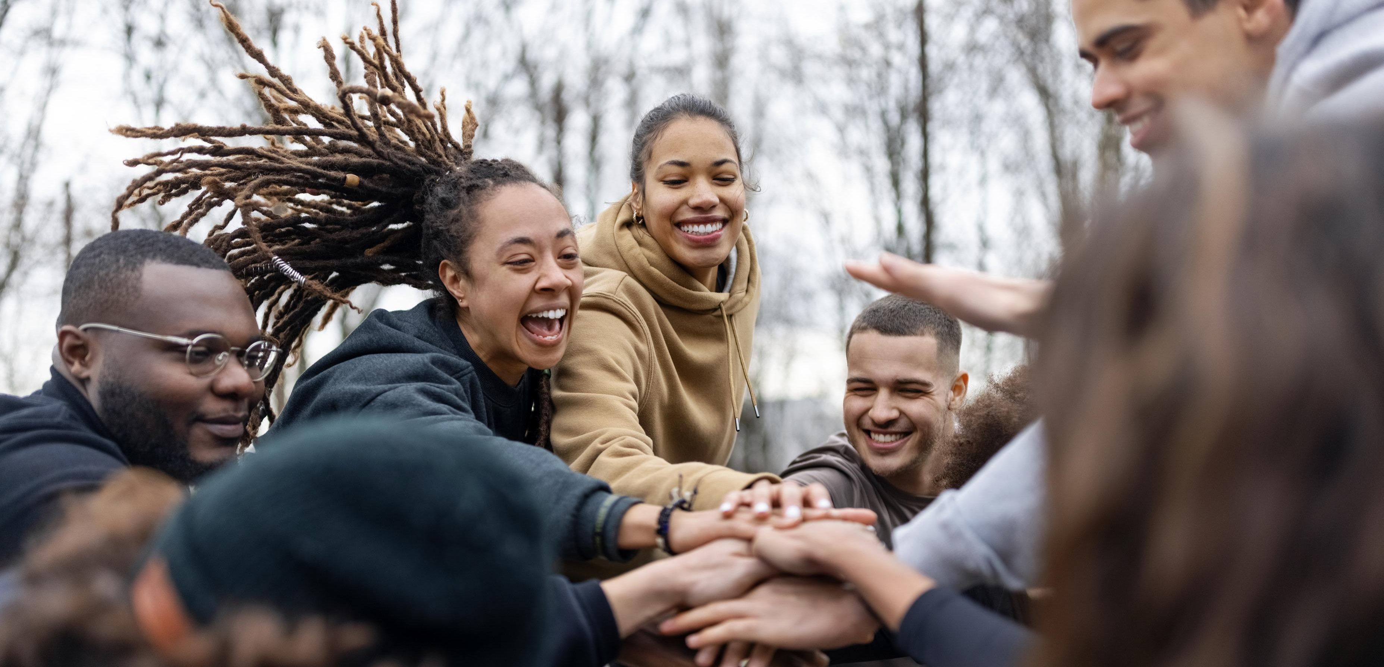
Going from Best to Better
Notes:
Warm-up:
President Elect has challenged us to think about what was our club’s best year ever? And then doing better than that year. Service and Impact, Membership, Foundation contributions, etc? Going from Best to Better. Take a moment to think about what was your best year, in the last 5 years and how can you make it even better?
Ask for a few people to share (5 minutes)

Slide 7
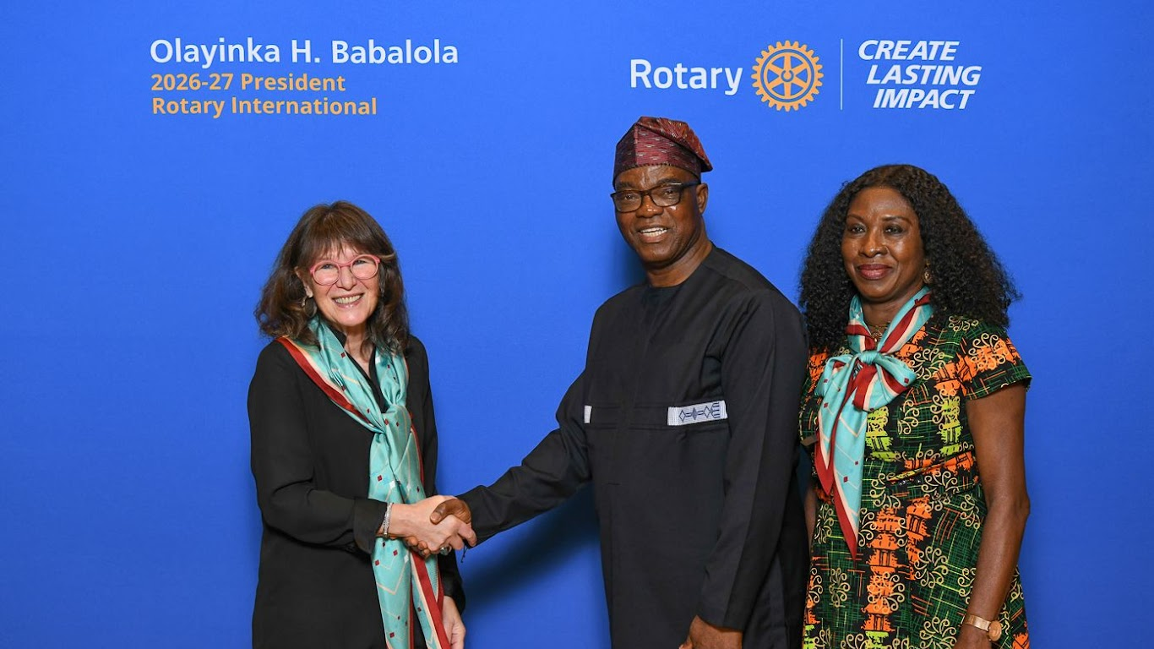
Official Photo with Yinka & Preba Babalola
Notes:
Note the scarf both Preba and I are wearing.

Slide 8

Building our Future with Purpose

Slide 9
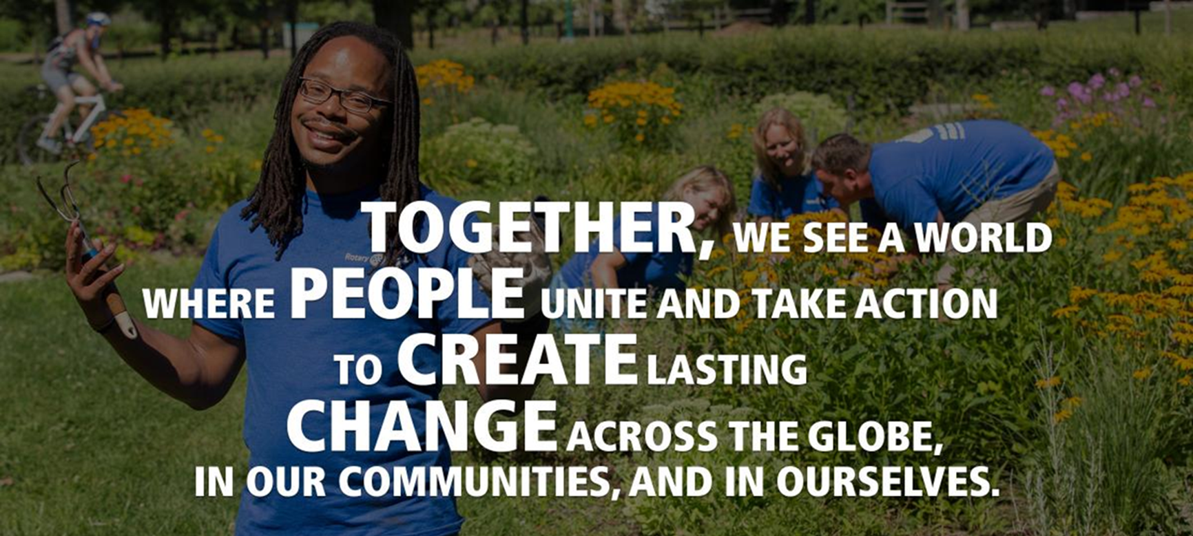
Rotary’s Vision
Notes:
Which word pops out for people – conversation in chat and call out
Rotary’s vision is a statement of purpose – it tells us that Together People Create Change
Change is about the future.

Slide 10
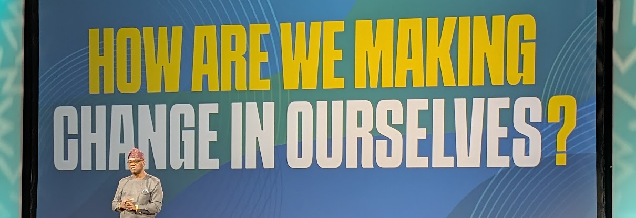
RIP Yinka – How do we make change in ourselves before we create change in our communities and across the globe?

Slide 11
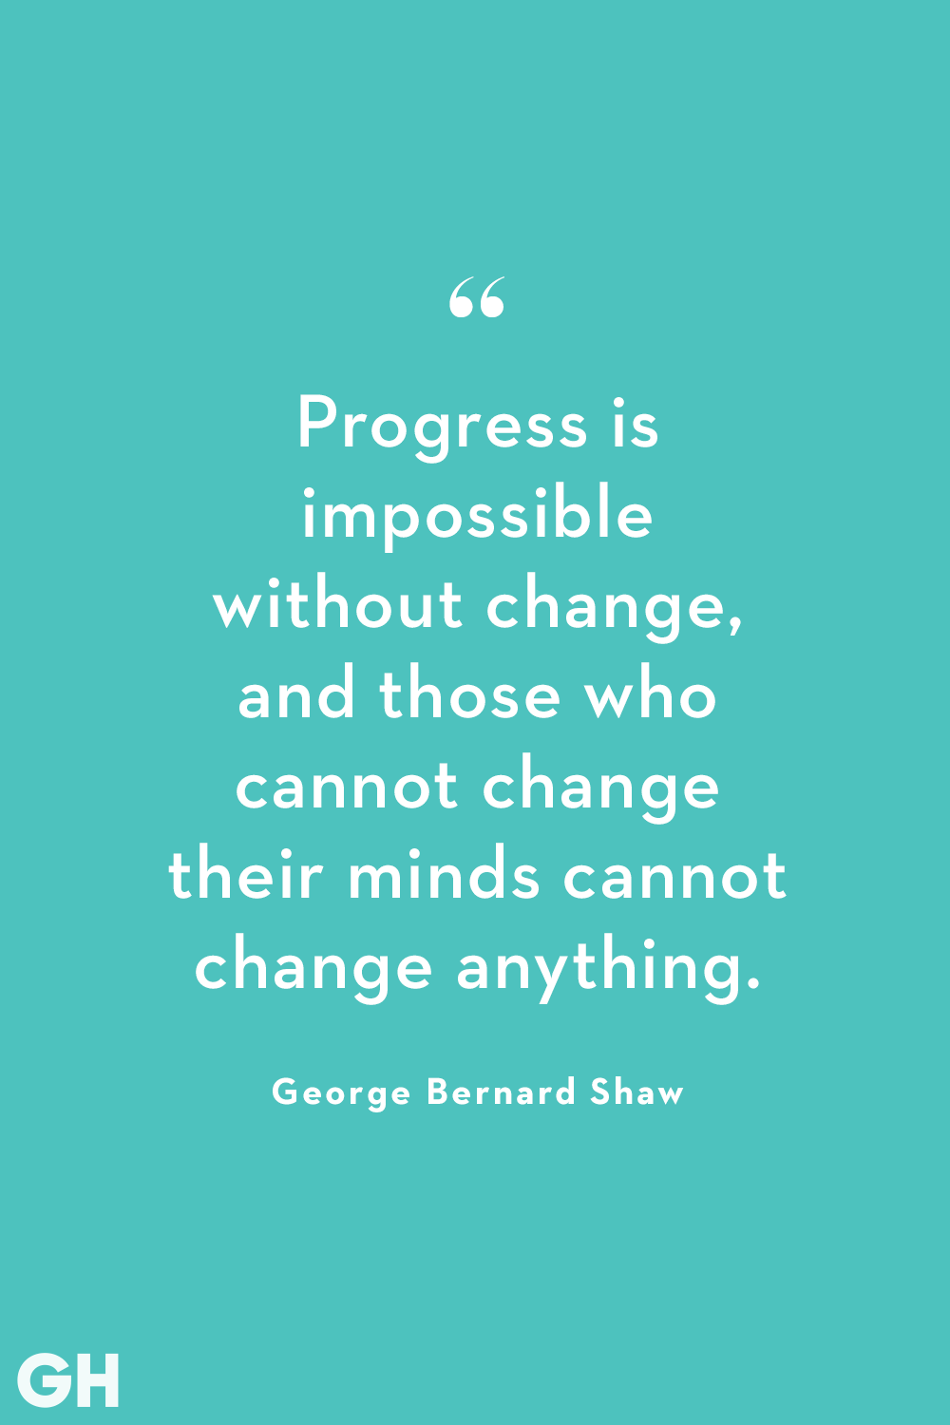
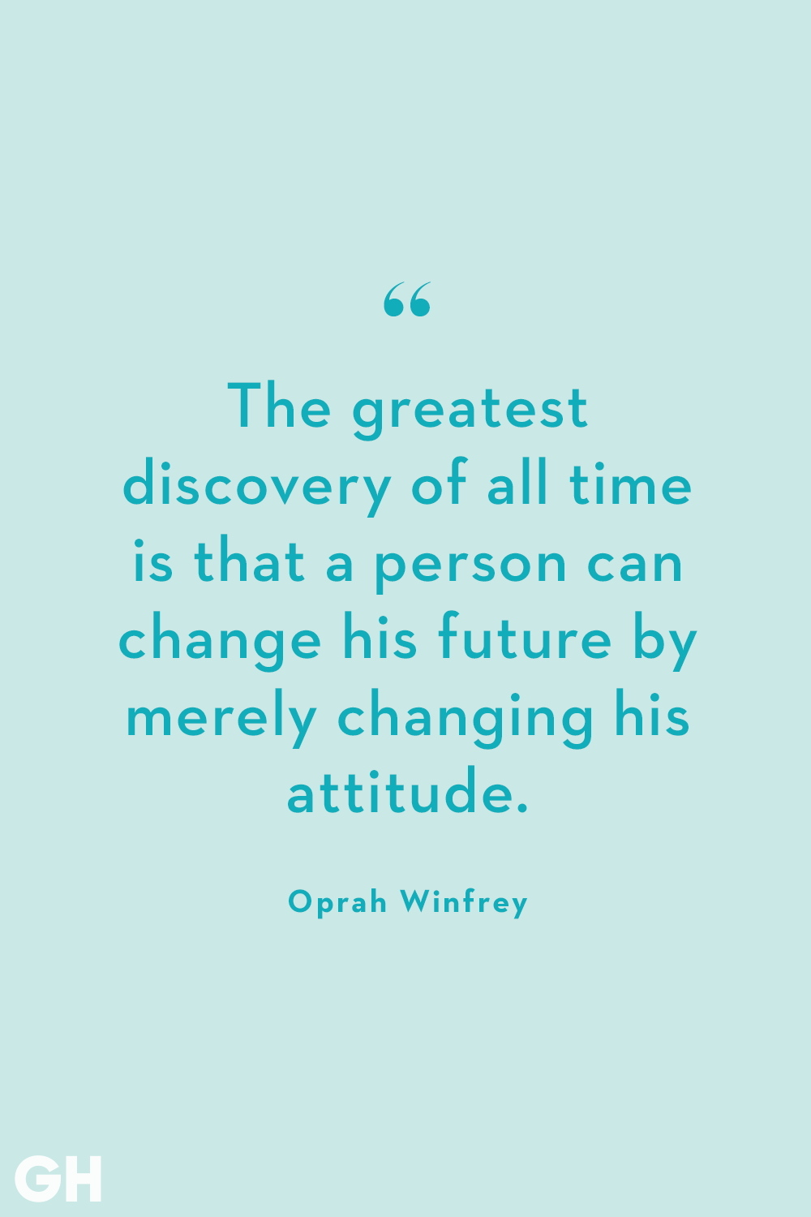
Notes:
The future is about change and changing within ourselves

Slide 12
Making Change with Purpose
Purpose helps us move beyond “this is how we’ve always done it” to “this is what matters now.”
Purpose helps us balance tradition with change
Rotary has always been about more than meetings—it’s about making a difference in our communities and around the world.
Rotary’s purpose is service, fellowship, and leadership
Notes:
Making change with purpose requires a plan otherwise change will happen anyway but not necessarily as you would like

Slide 13
The Benefits of Purpose
Purpose attracts members who want meaning, not just meetings
Engagement grows when people feel useful and valued
Reputation builds as purpose is realized
Community benefits when clubs have purpose
Notes:
Having purpose, having a plan has many benefits.

Slide 14

Rotary’s Action Plan

Slide 15
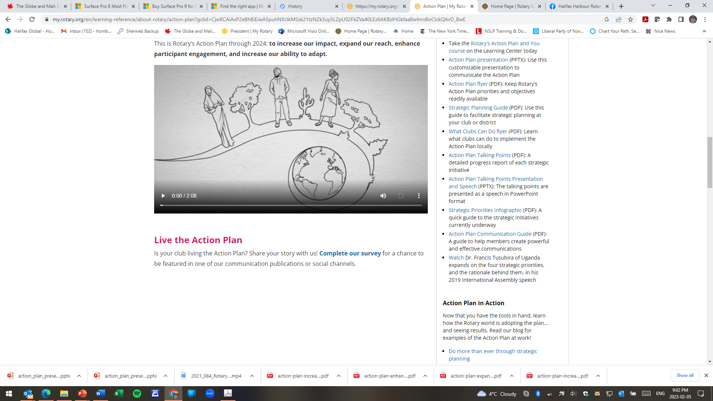
RI Action Plan
Notes:
Bring up You Tube video in background

Slide 16
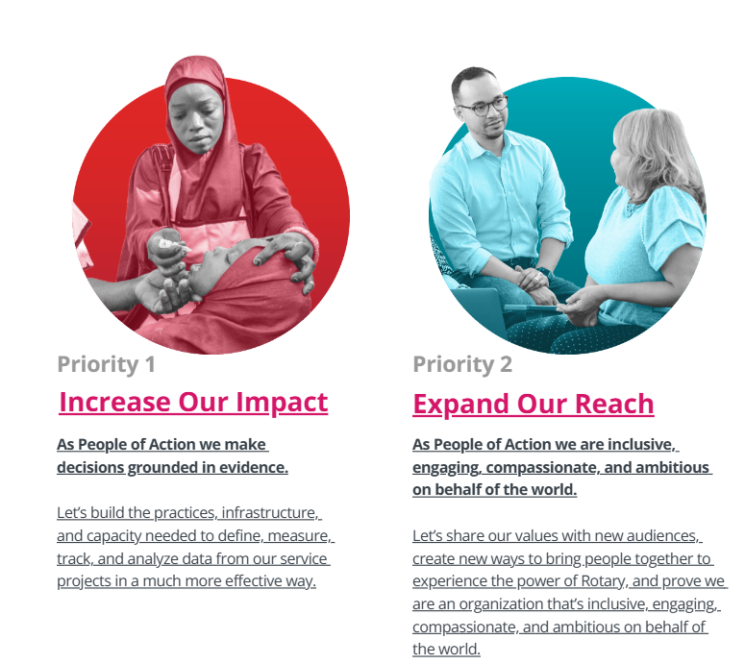
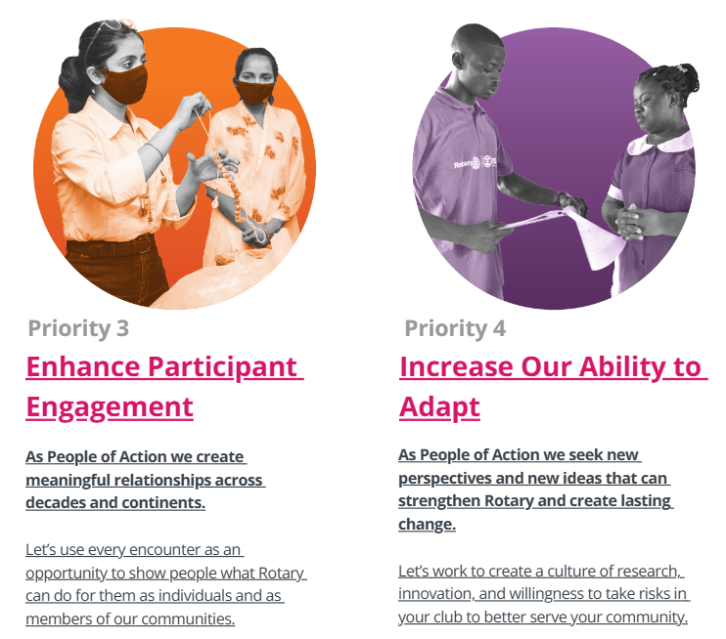
Rotary’s Action Plan Priorities

Slide 17
Increase Our Impact
Every club, can significantly increase impact by gaining a greater sense of focus.
What will be my club’s legacy? The answer starts with defining and measuring the impact we have on our community.
What targets will my club commit to for Foundation giving, service projects and Youth Exchange for this Rotary year?

Slide 18
Expand Our Reach
People around the world know about Rotary. A survey in 15 countries showed that we’re among the top three social service organizations in the world in terms of awareness.
But only 35% of respondents saw Rotary as an organization for people like them. And just 25% of people surveyed said they knew someone in Rotary
There are many ways people connect. Let’s look around our community and think about who the leaders are — keeping in mind that there are many different ways to be a leader.
What measurable goals will our club set this Rotary year to expand its reach through membership, youth programs and media visibility?

Slide 19
Enhance Participant Engagement
Enhancing participant engagement means that whenever someone engages with Rotary — through a club, a program, or even an event — they have an experience that exceeds their expectations.
It also means that once someone is on the Rotary path, it’s as exciting, fulfilling, and meaningful in decade five as on day one.
How can my club enhance engagement of our members & attract new members? How will we know that members are more engaged?

Slide 20
Ability to Adapt
People of action are inventive, entrepreneurial, and resilient. We’re driven by a sense of optimism — a belief that we are and will continue to be essential to our communities, to the world, and to humanity.
We need to look at how we can adapt more quickly to a changing world, how new perspectives can strengthen Rotary, and what new ideas could create lasting change.
What does my club need to do to adapt to a changing world? How will our action plan, enhanced online presence and review of our governance structures help to get us there?

Slide 21
Break Out Groups
Each group is assigned one priority
Discuss questions at the bottom of each slide
Notes:
Turn over to Candace

Slide 22

What Now?

Slide 23

How is your club going to go from best to better?

Slide 24

Getting from Best to Better…by Setting Goals
How will your club be better than it’s ever been?
What will your club do in the next year that will be different?
Next PELS and SELS session includes how to set goals in Clubrunner or hard copy

Slide 25
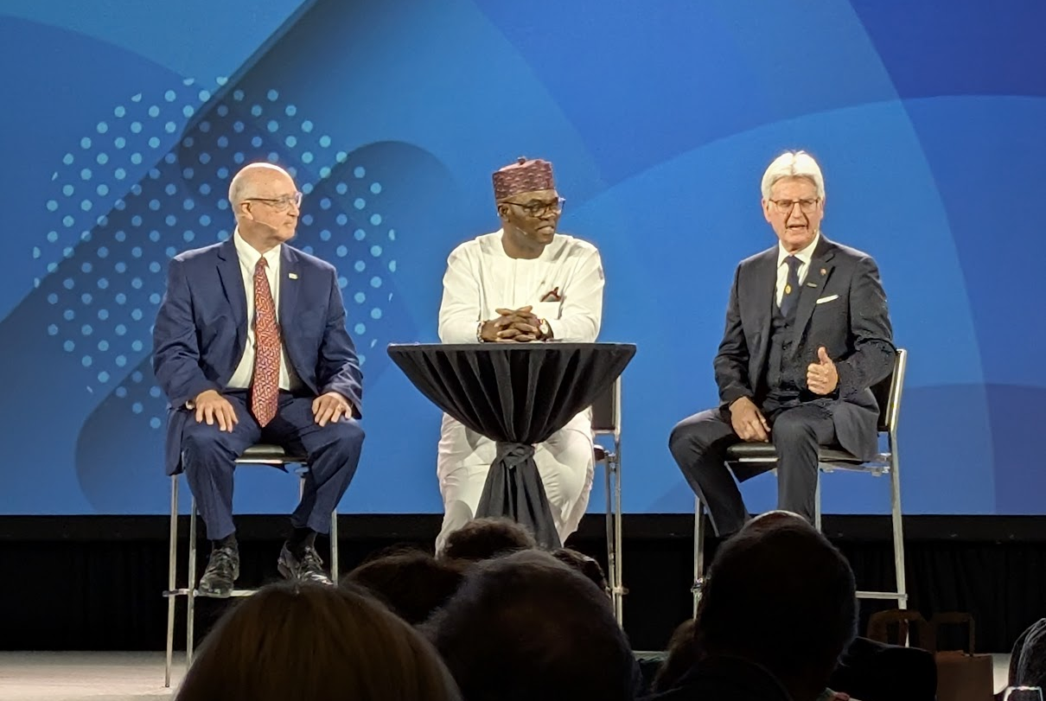
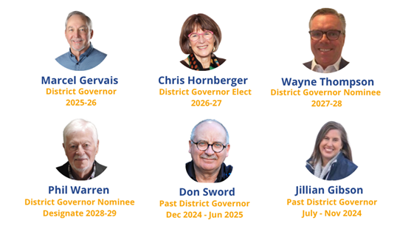
Succession Planning
Internationally and in the District
Notes:
Getting from best to better involves collaboration, consistency and continuity
Who is your President Elect and President Nominee?
Rotary International President Nominee Larry Lunsford
Rotary International President Elect Olayinka Babalola
Rotary International President Francesco Arezzo

Slide 26
Club Succession Planning
Have you entered your team for next year in Clubrunner?
Congrats to those who have!

Slide 27
What’s Next?
Pre-PELS and SELS Action Lab sessions online
February 18th
Nuts & Bolts with Holly Thompson and Candace Boone
March 31st
Successful Clubs with Louisa Horne
April 22nd
So, You’re the President - What I Wish I’d Known with a panel of Club Presidents followed by Q&A
In-person PELS and SELS on May 29th in Shediac, NB
Notes:
Note that all sessions are one hour starting at 7:00 / 7:30

Slide 28
Resources
RI Learning Centre – Club Leadership
RI Learning Centre – Professional Development
Club and District Administration
Rotary Club Central Resources
The Action Plan Toolkit

Slide 29

Final Thought
The future of Rotary isn’t something we inherit - it’s something we shape, one purposeful decision at a time.

